Slide 1
Optimization of Food wastage in Restaurants
Team Members
Irfan Saleemudeen Sashank Addanki Venkata Naga
Rithik Rathinavel Raghupathi
Lakshmi Srujana Sushma Pedapati
Saketh Varma kalidindi
Naik Satti Kartik

Slide 2
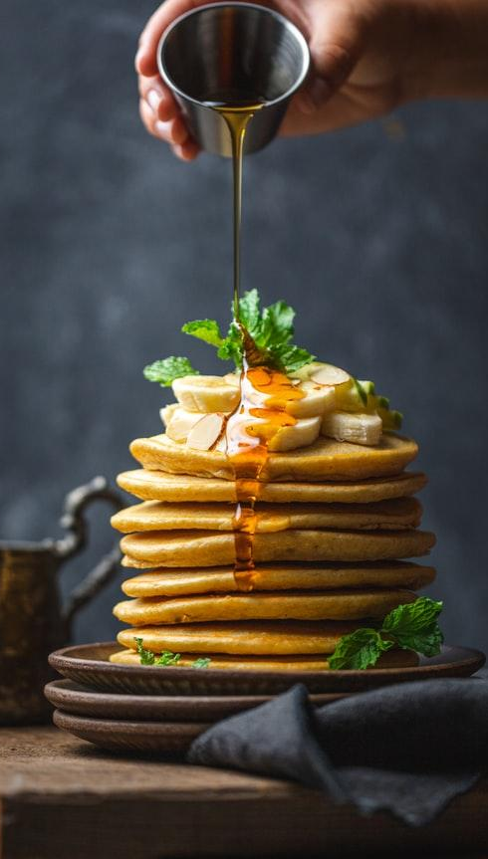
Introduction
Food wastage at large events is a growing concern.
Over-preparation leads to unnecessary cost and environmental harm.
This project addresses the challenge of minimizing food wastage at events by determining optimal food preparation quantities using Python-based optimization techniques.
A linear programming model is used to minimize total food waste while ensuring that the minimum food requirement per guest is met and that the budget constraints per food type are not exceeded.
Additionally, the project includes a sensitivity analysis module, which simulates different scenarios by varying:
Budget limits,
Guest attendance rates, and
Wastage rates.

Slide 3
Data Preparation
Source: Kaggle.com
Key columns:
-Type of Food
- Event Type
- Number of Guests
- Pricing (Low, Moderate, High)
- Wastage Food Amount
Assumptions :
-10% no-show rate
-each guest needs at least 0.5 units of food
Derived columns:
-Cost per unit
-Actual guests
- Pricing category is converted into numerical values (Low = 200, Moderate = 400, High = 600).

Slide 4
food_wastage_data.csv
Purpose: This is the base dataset used for analysis and optimization. Key Columns: Type of Food: Name or category of food (e.g., Meat, Fruits, Vegetables, Dairy Products, Baked goods). Event Type: Type of event (e.g., Wedding, Corporate, Birthday, Social Gathering). Number of Guests: Total guests expected at the event. Pricing: Category of food cost (Low, Moderate, or High). Wastage Food Amount: Estimated amount of food wasted per unit. Use: Provides the input for optimization constraints and the objective function

Slide 5
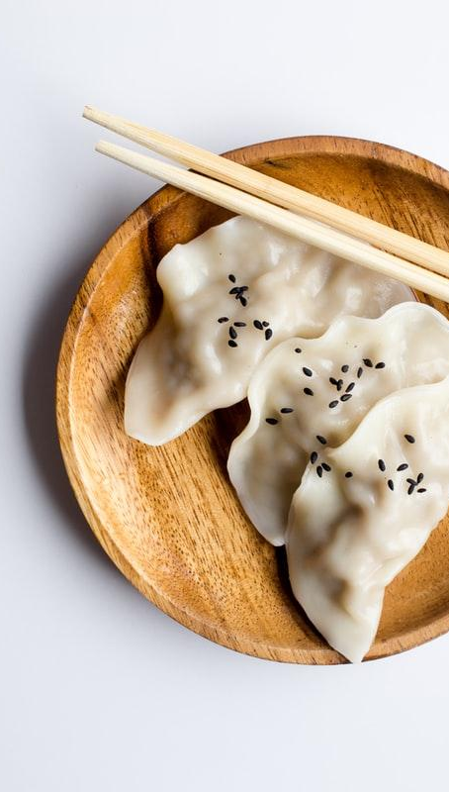
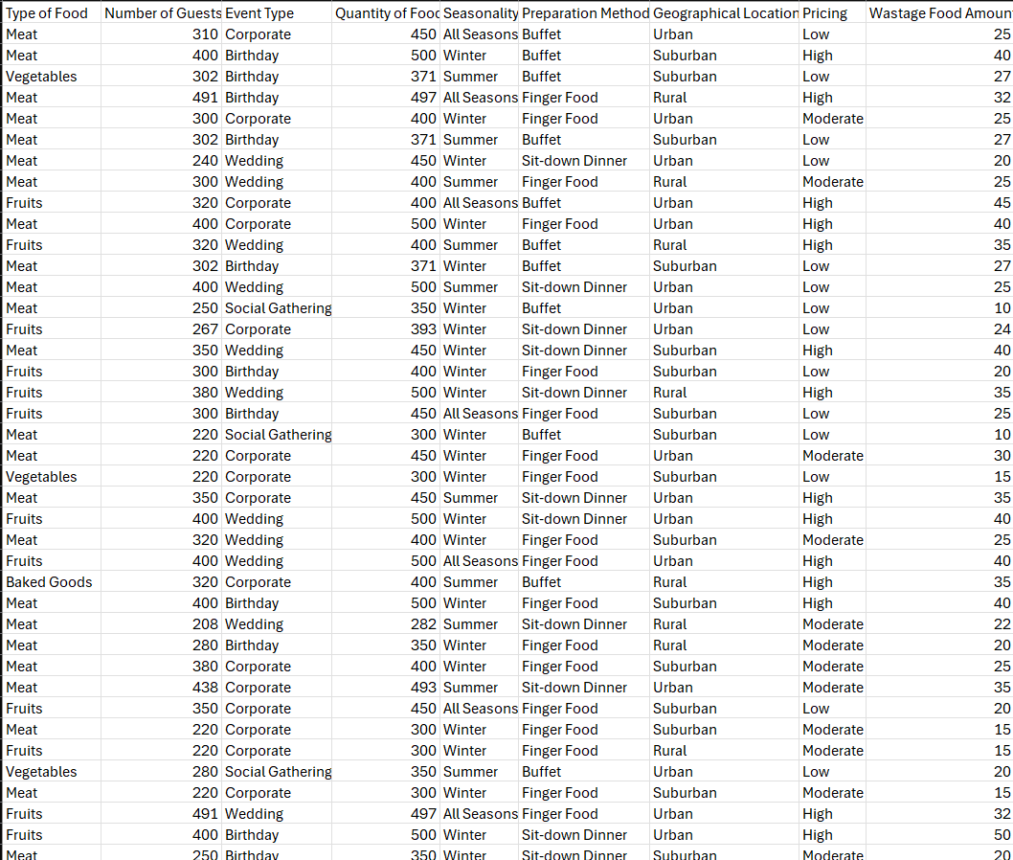
Data Set

Slide 6
Optimization Process
Objective: Minimize the total food wastage.
Constraints
Budget constraint: Total cost of food must not exceed the budget.
Food quantity constraint: Each guest must receive at least 0.5 units of food.
The optimization uses the 'linprog' function from SciPy with the 'highs' method to solve this linear problem. If successful, the solution provides the optimal quantities of each food type to prepare. These results are saved in 'Optimal_Food_Preparation_Quantities.csv'.

Slide 7
Optimal_Food_Preparation_Quantities.csv
Purpose: Contains the optimized quantity of each food item to prepare, aiming to minimize wastage.
Key Columns: Type of Food: Name of the food item. Event Type: Associated event type. Optimal Quantity: Quantity to prepare as per optimization. Wastage Per Unit: Original wastage rate per unit. Cost Per Unit: Cost per unit derived from the pricing category.
Use: Helps planners make informed decisions on food quantities while minimizing waste.

Slide 8
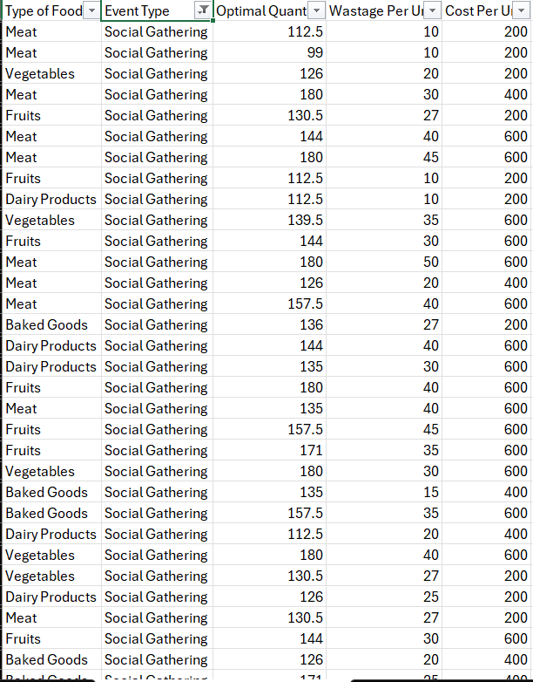
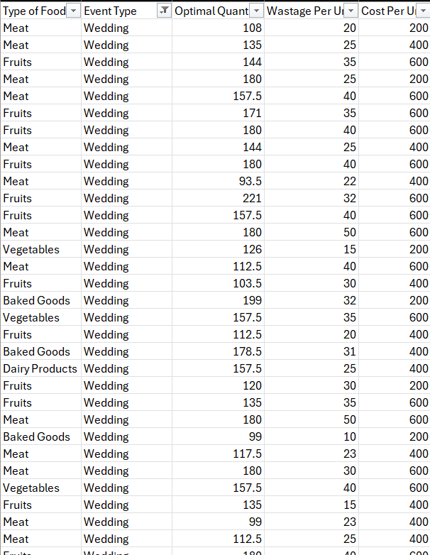
Optimization Results

Slide 9
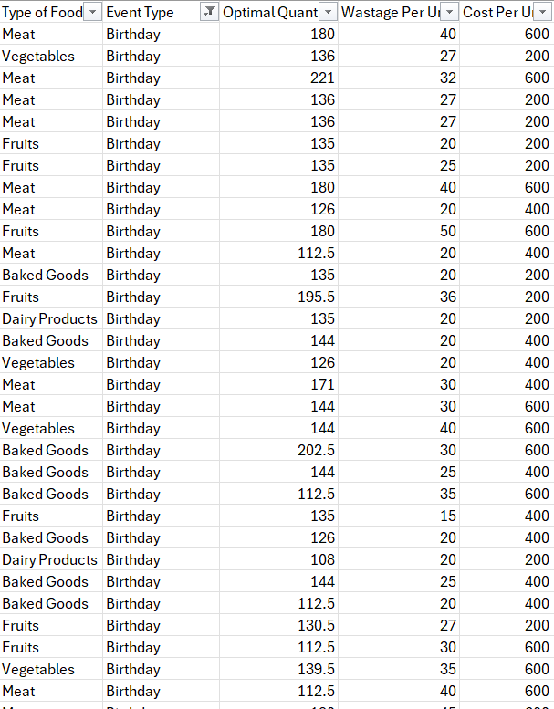
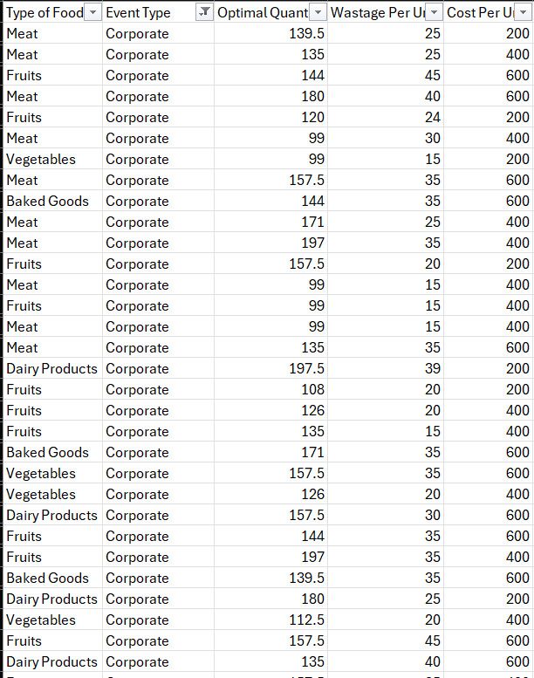
Optimization Results

Slide 10

Sensitivity Analysis
Sensitivity analysis checks how the optimization solution behaves under different conditions. The scripts tests range of values for:
Budget (from 300 to 1000)
Guest attendance (20% to 100% of expected guests)
Wastage rates (from 0.5x to 1.5x the original wastage)
For each scenario, the script recalculates and re-runs the optimization. The results show whether a valid solution was found and what the total wastage would be. These are saved in 'Sensitivity_Analysis_Results.csv'.

Slide 11
Sensitivity_Analysis_Results.csv
Purpose: Summarizes how changes in budget, guest attendance, and wastage rates impact the optimization result. Key Columns: Budget: Budget used in that test scenario. Guest Factor: Multiplier applied to guest turnout. Multiplier applied to wastage per unit. Optimal Wastage Factor: Resulting minimized wastage. Status: Whether the solution was optimal or infeasible. Use: Helps understand model sensitivity and supports planning under uncertainty.

Slide 12
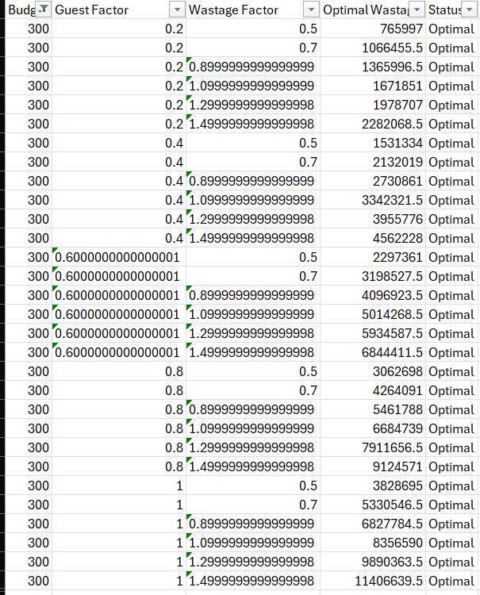
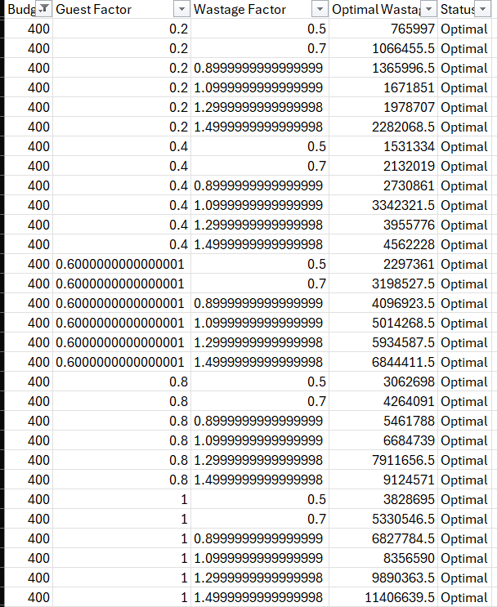
Sensitivity Analysis Results

Slide 13
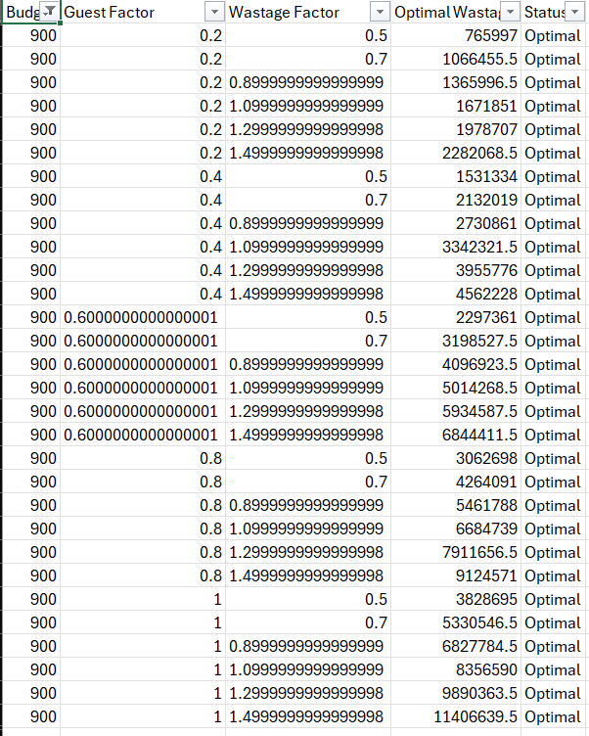
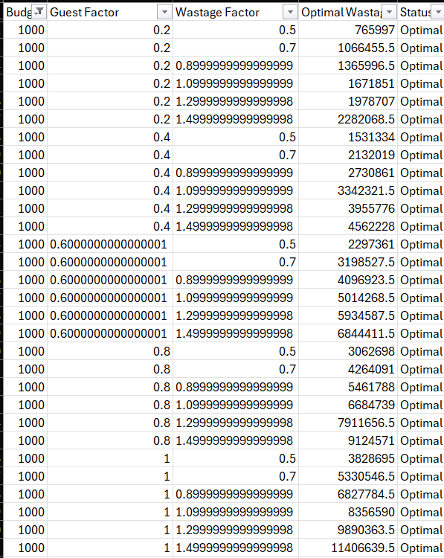
Sensitivity Analysis Results

Slide 14
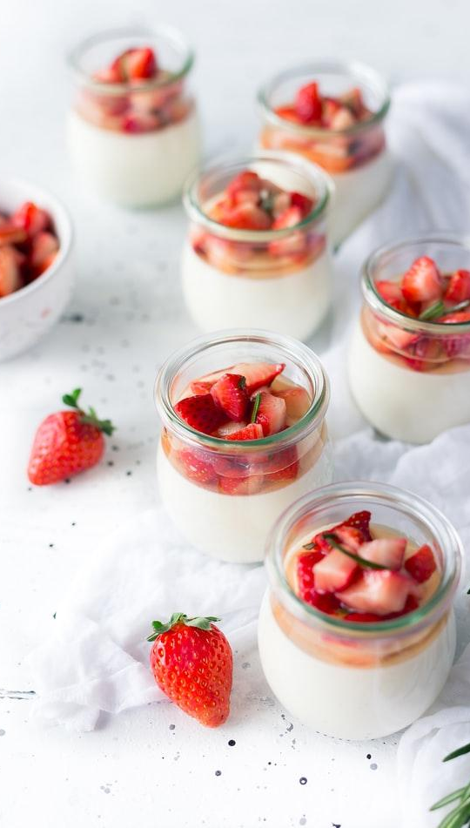
Limitations
Assumed No-Show Rate
Fixed Minimum Food Requirement
Static Cost Mapping
Simplified Budgeting
Linear Model Assumptions
No Satisfaction Metrics
Scalability

Slide 15
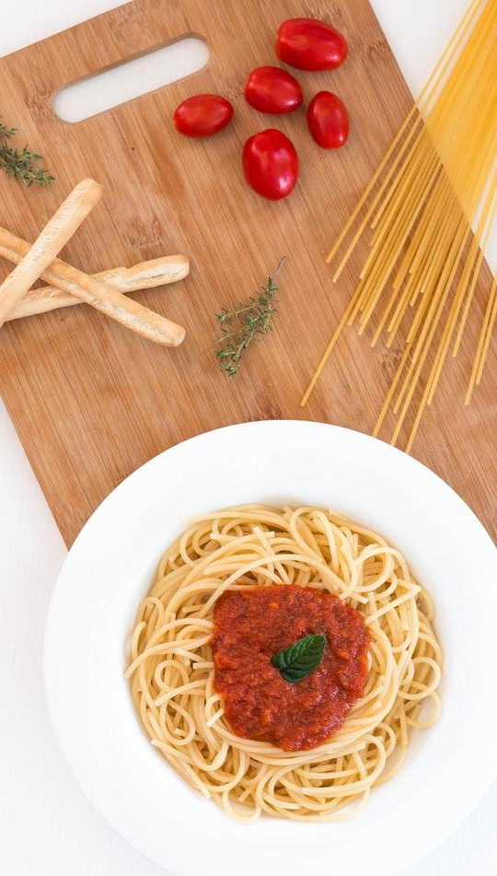
Future Work
Dynamic No-Show Modeling
Incorporate Guest Satisfaction
More Sophisticated Cost Modeling
Stochastic Optimization
Non-Linear and Multi-Objective Models
Integration with Real-Time Event Data
Visual Dashboards

Slide 16
Summary
This project uses optimization to support event planners in reducing food waste while meeting guest needs and staying within budget. It also evaluates how sensitive the model is to changes in key variables, which helps in planning under uncertainty.

Slide 17

Thank You

